Slide 1

Final Project Build Transformer Models for Bidirectional Translation between English and French
Liu, Yan
CSCI S-89a Deep Learning, Summer 2019
Harvard University Extension School
Prof. Zoran B. Djordjević

Slide 2
Introduction
Transformer model with Self-Attention Mechanism
Two Transformer Models for Bidirectional Translation
Between English and French
Attention is interesting. Self-attention is even more interesting!
While attention mechanism is an interesting discovery to assist decoders in neural machine translation model, self-attention mechanism further develops the idea and get rid of the limit of sequential model to allow us to make the best use of parallel processing computing power and gives us decent results.
Translation is interesting. Bidirectional Translation is even more interesting!
Through this project, the author aims to explore how well a machine learns by comparing its translation back and forth. Specifically, I trained two transformer models, one to translate from English to French, the other to translate from French to English with the same data.

Slide 3
Configurations
Hardware:
Google Colab with Python 3 Google Compute Engine Backend GPU
25GB RAM
360 GB Disk (could be smaller)
2 min/ 100 Steps * 1300 Steps/ Epoch * 3 Epochs = 2 hours for training
Software:
Pytorch 0.3.0 for Linux 64 Bit machine
Torchtext 0.2.3
Fastai 0.7.0
Torchvision 0.1.9

Slide 4
Dataset
Training Data:
IWSLT English
IWSLT French
https://sites.google.com/site/iwsltevaluation2017/TED-tasks
Preprocessing Language Resource:
SPACY en, fr

Slide 5
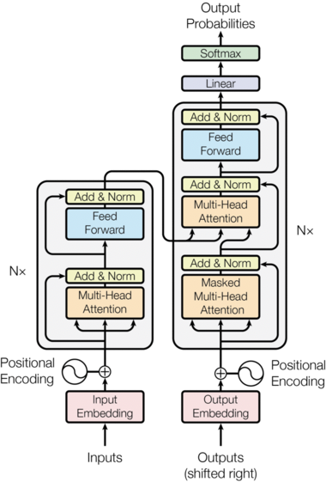
Model Architecture
The Transformer follows this overall architecture using stacked self-attention and point-wise, fully connected layers for both the encoder and decoder, shown in the left and right halves of Figure on the left, respectively.
The encoder is composed of a stack of Nx=6 identical layers.
(Borrowed from lecture slides)

Slide 6

Self-attention Revised for Masks
Image bellow shows the position each target word (row) is allowed to look at (column). Words are blocked for attending to future words during training.

Slide 7
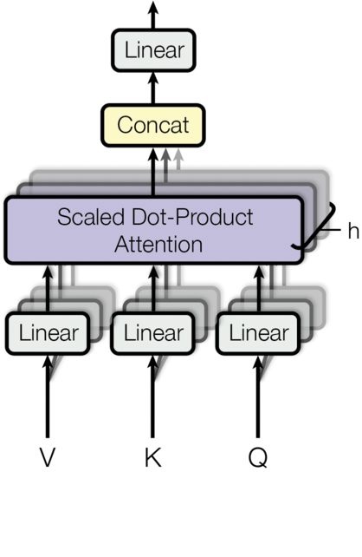
Multi-head Attention
Why Multi-head Attention?
“In these (traditional) models, the number of operations required to relate signals from two arbitrary input or output positions grows in the distance between positions …… This makes it more difficult to learn dependencies between distant positions. ”
“In the Transformer this is reduced to a constant number of operations, albeit at the cost of reduced effective resolution due to averaging attention-weighted positions, an effect we counteract with Multi-Head Attention.”

Slide 8
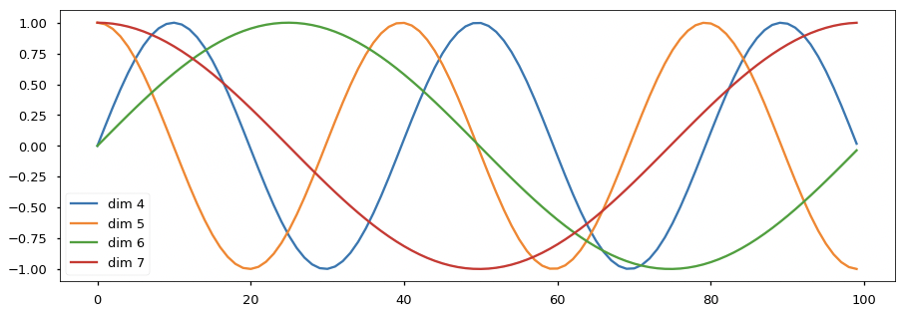
Position Encoding with sin() and cos()
@Liu Yan

Slide 9
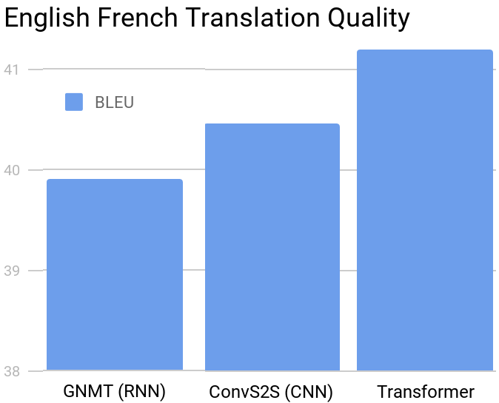
Translation Example
From French to English:
BLEU _{FRtoEN} = 0.2273
Reference English:
Who calls whom ?
Who sends whom an email ?
Translated English:
Who calls who ?
Who is sending a email to which ?
From English to French:
BLEU _{FRtoEN} = 0
Reference French:
Au final , notre initiative a été adoptée et fut une réussite.
Translated French:
Etes maison-mère composaient avion-fusée internaliser traitements longtemps …

Slide 10
Summary
Keeping packages in use compatible with each other requires essential consideration when writing code. Package versions must be detailly documented.
While the idea to test the quality of the translation by training two models to translate back and forth is interesting, to fully explore the potential effects would require a good grasp of appropriate data.
Learning rate must be wisely chosen (such as in the case of translating from French to English) and the best learning rate may not be universal (such as in the case of translating from English to French). A different optimization algorithm might be necessary to further improve the English-to-French language model.
BLEU score is still a good indicator for translation quality.
@Liu Yan

Slide 11
YouTube URLs, Last Page
Two minute (short): https://youtu.be/Lp79IAF1XFQ

